Slide 1
Group No. 23
IIT2018001
IIT2018007
IIT2018008
IIT2018031
IIT2018069

Slide 2
Problem Statement
When do we use the hierarchical architecture in the trust model and when do we use the mesh architecture. Explain how a user under one CA can obtain the certificate of a user under another CA in both the architectures using examples .

Slide 3
Hierarchical Architecture:
It is implemented as an inverted tree structure.
It has a centralized unit called Root.
Root is the starting point of the hierarchical tree structure.
It is used in military, government and industries

Slide 4
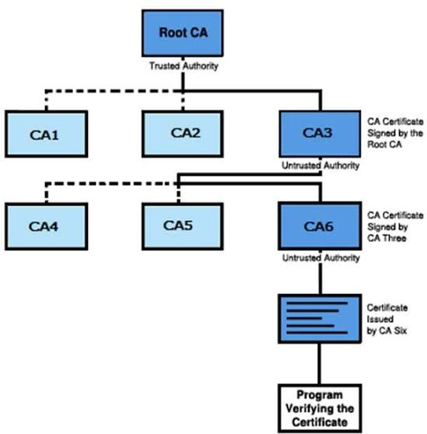

Slide 5
Mesh Architecture:
There is no centralized node in the structure unlike hierarchical tree structure.
It’s structure resembles to how people trust each other in day to day life
This model is useful in small groups which have pre-existing relationship

Slide 6
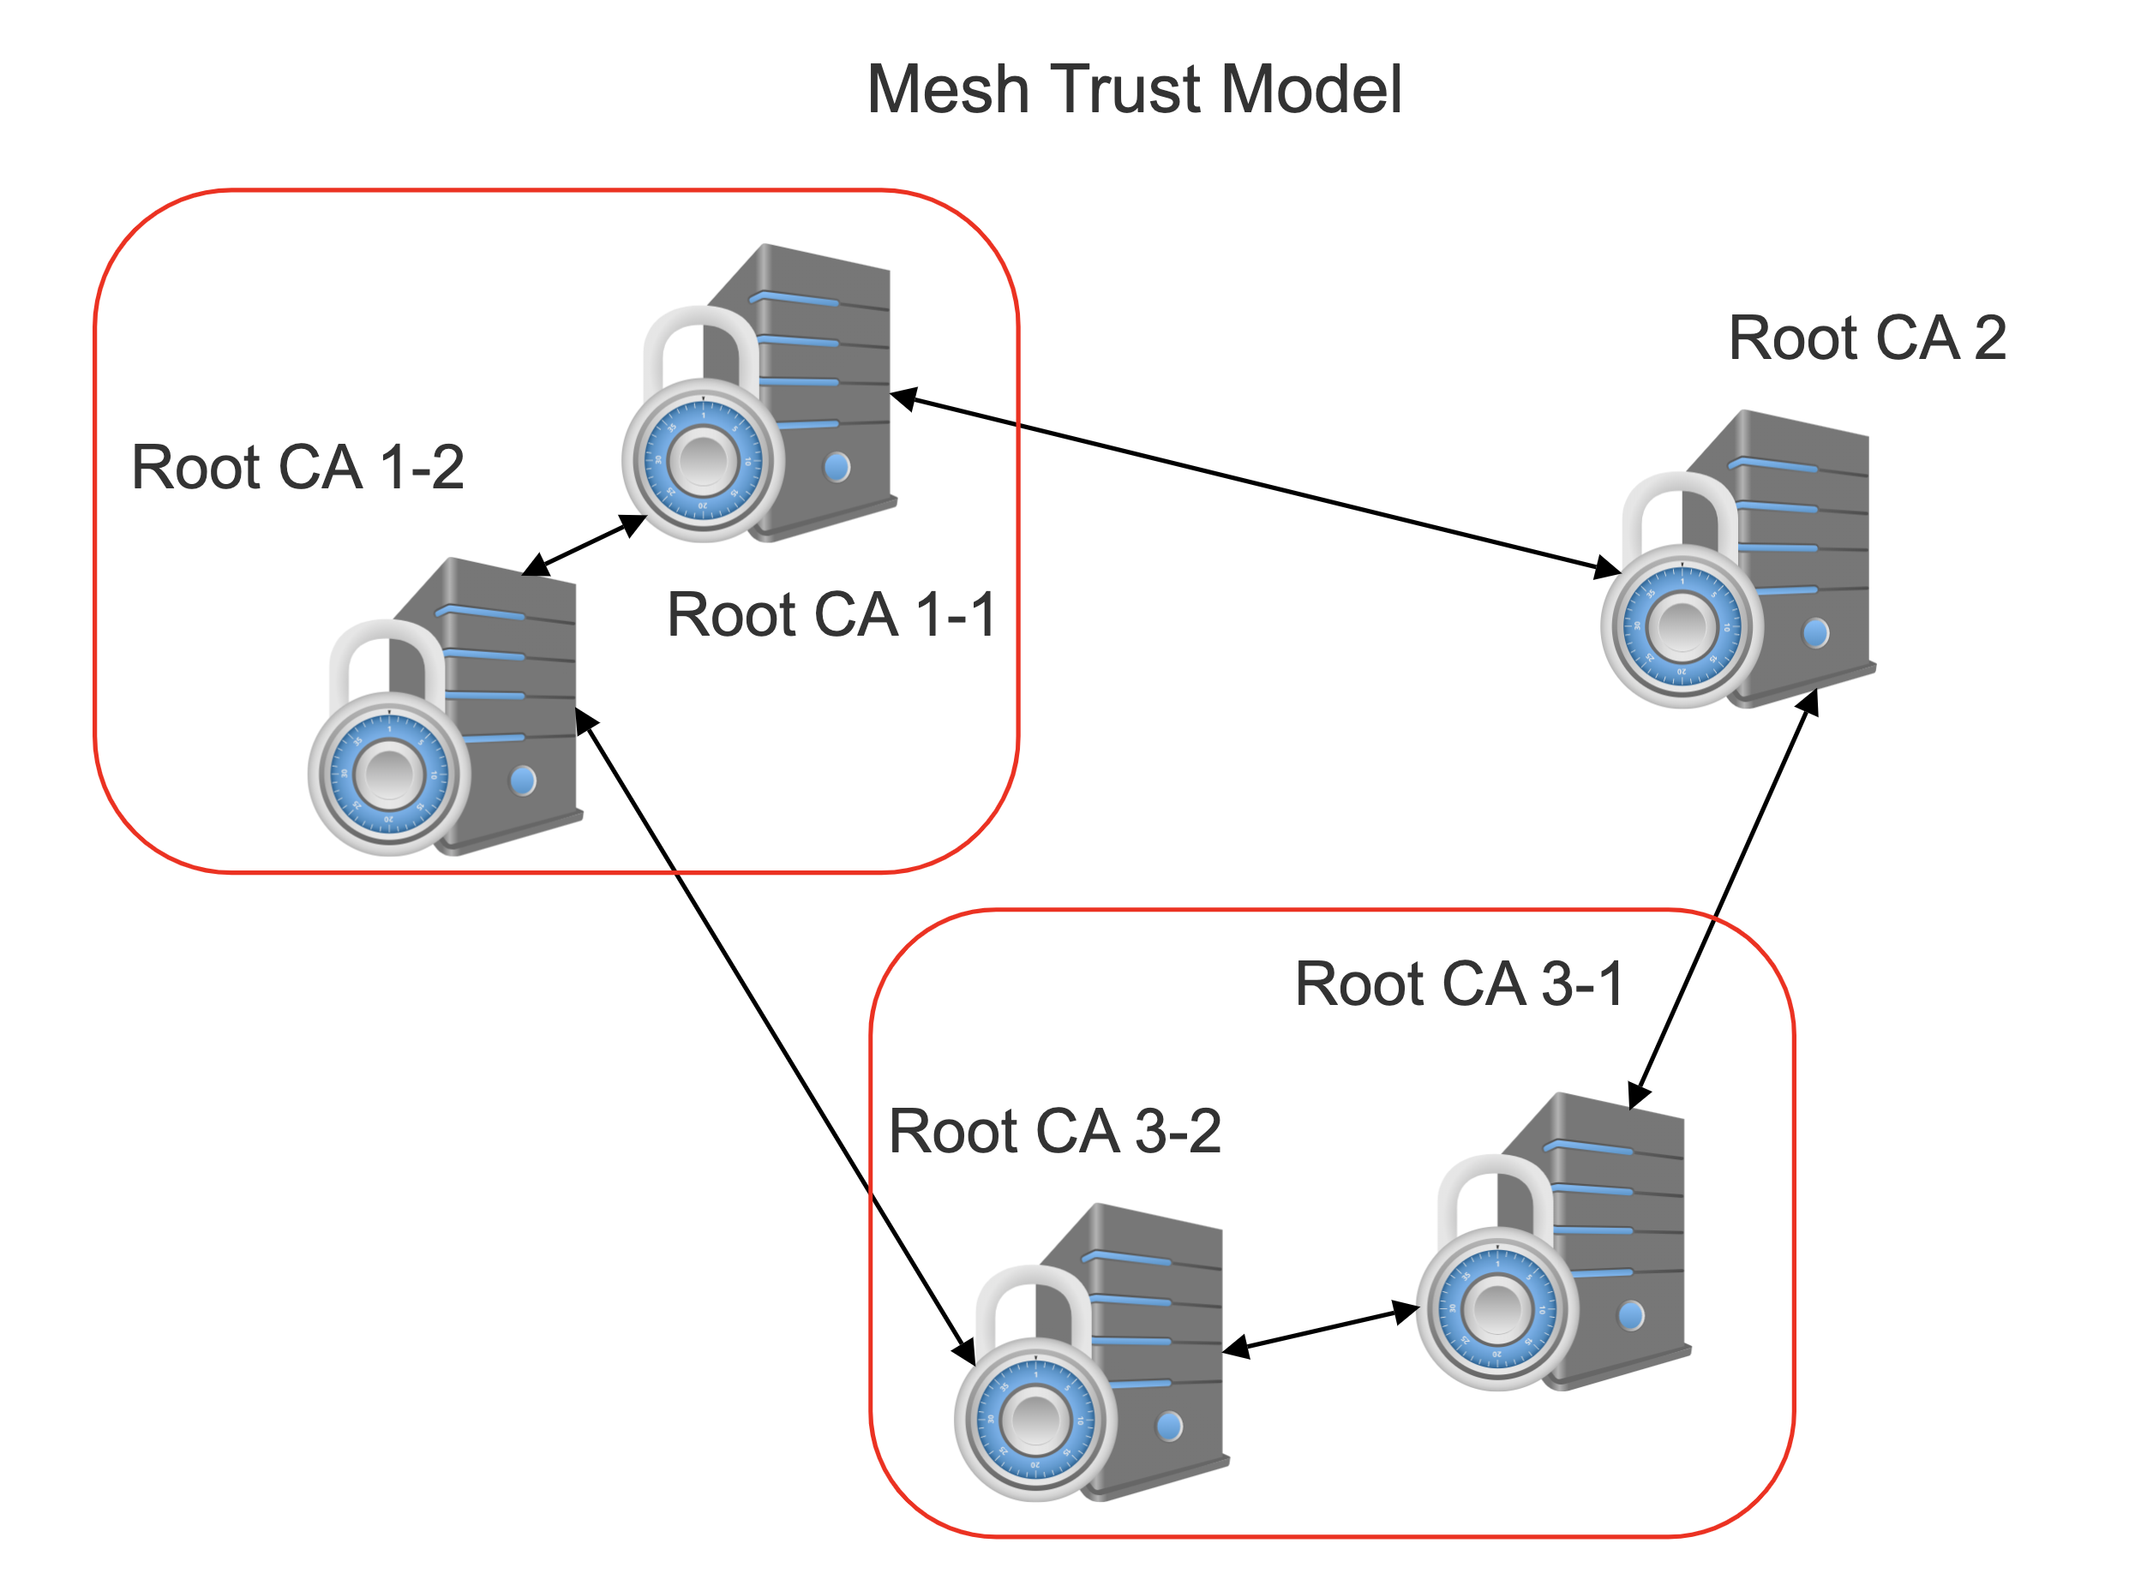

Slide 7
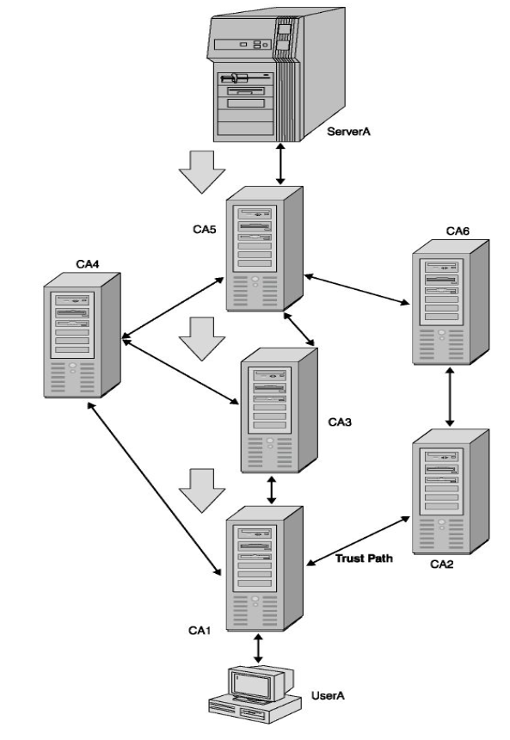
Example of Mesh Architecture
User A has a certificate which has been issued by CA 1 and needs to access the data present on the Server A. Server A has a certificate which has been issued by CA5.

Slide 8
Working Process:
1.User A sends its certificate to Server A for the verification.
2.Certificate of User A is verified with CA1
3.Certificate of CA1 is verified with CA3.
4.Certificate of CA3 is verified with CA5.
Since the Server A relies on CA5 and CA5 trusts CA3, CA3 trusts CA1, and CA1 is the one which has issued the certificate for User A, so the certificate of User A is valid .

Slide 9
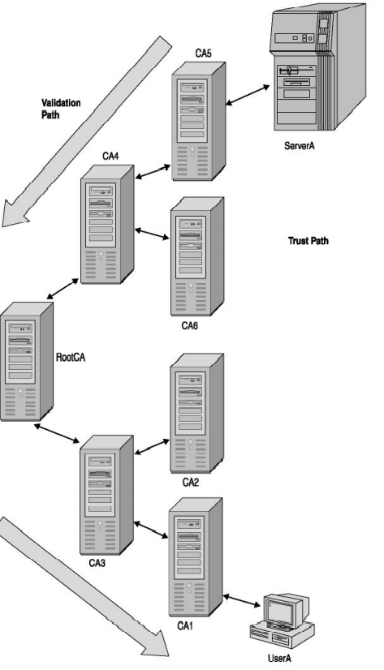
Example of Hierarchical architecture
User A has a certificate which has been issued by CA1 and needs to access the data present on the Server A.Server A has a certificate issued by CA5

Slide 10
Working Process:
1.User A sends its certificate to Server A for the verification.
2.Certificate of User A is verified with CA1.
3.Certificate of CA1 is verified with CA3..
4.Certificate of CA3 is verified with Root CA.
Since every node trust Root CA and Server A relies on Root CA,so if Root CA trusts CA3,CA3 trusts CA1, and CA1 has issued the certificate for User A,so the certificate of User A is valid.

Slide 11
THANK YOU !

